Slide 1
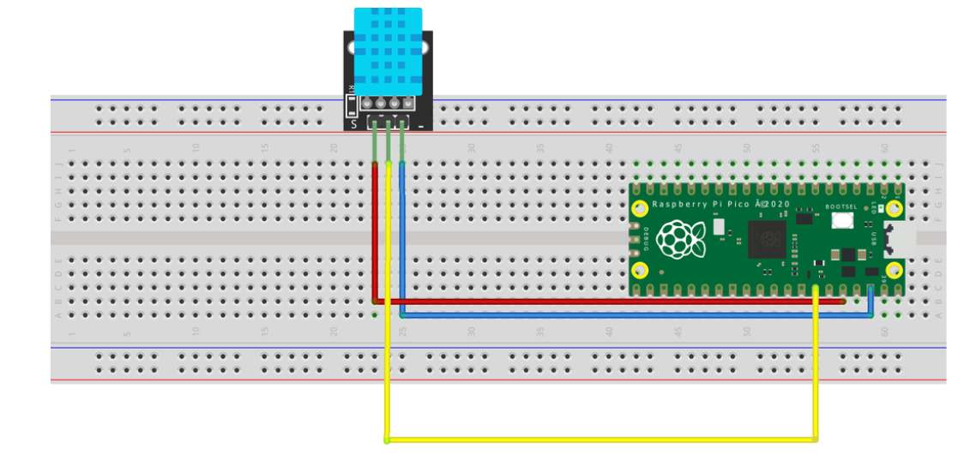

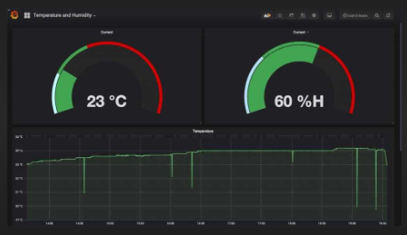
Pico as Data Logger
Connected to : ('192.168.1.95', '255.255.255.0', '192.168.1.1', '192.168.1.1')
grafana
Wifi
SSID=VirusGenerator
PWD=VGAquarius090317
upython Code
.py
192.168.1.100
INFLUXDB
SERVER

Slide 2
Setting up the Influx Database
Part 1

Slide 3

STEP 1
https://portal.influxdata.com/downloads/
Scroll down to
Are you interested in InfluxDB 1.x Open Source?
Drop down V arrow and select
InfluxDB v1.8.10
Platform: Windows Binaries (64 Bit) - using PowerShell

Slide 4
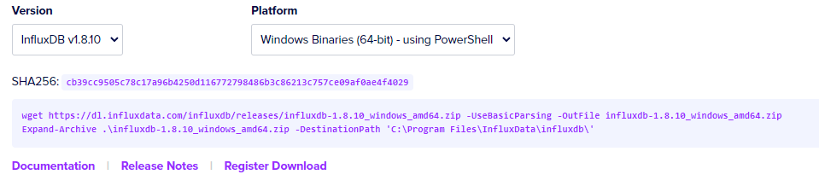
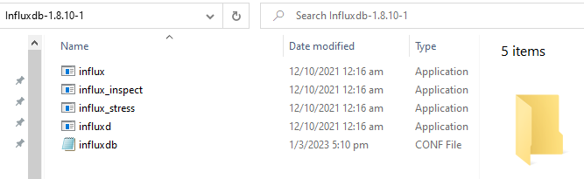
wget https://dl.influxdata.com/influxdb/releases/influxdb-1.8.10_windows_amd64.zip
Expand-Archive .\influxdb-1.8.10_windows_amd64.zip -DestinationPath 'C:\Program Files\InfluxData\influxdb\'

Slide 5
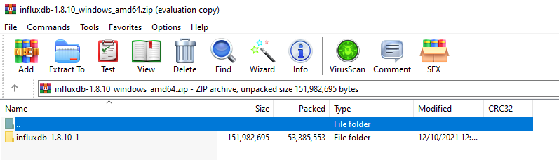
https://dl.influxdata.com/influxdb/releases/influxdb-1.8.10_windows_amd64.zip
Short Cut
Use a browser and https to download zip file
https://dl.influxdata.com/influxdb/releases/influxdb-1.8.10_windows_amd64.zip
influxdb-1.8.10_windows_amd64.zip will be downloaded to Downloads folder
Right click on this folder, copy it and paste to C Drive root directory

Slide 6
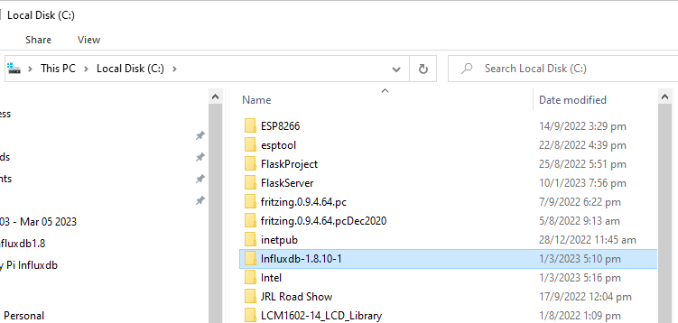
Rename this folder to something easy to remember
e.g. Influxdb

Slide 7
Influxd is the daemon / service for influxdb
Influx is the query language which is used for
database creation
user creation
Inserting measurements
Querying measurements
They are run in Terminal / Powershell mode

Slide 8
Setting up the Influx Database
Part 2

Slide 9
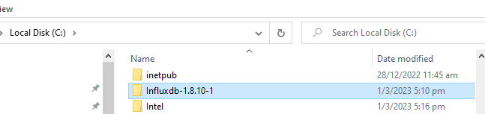
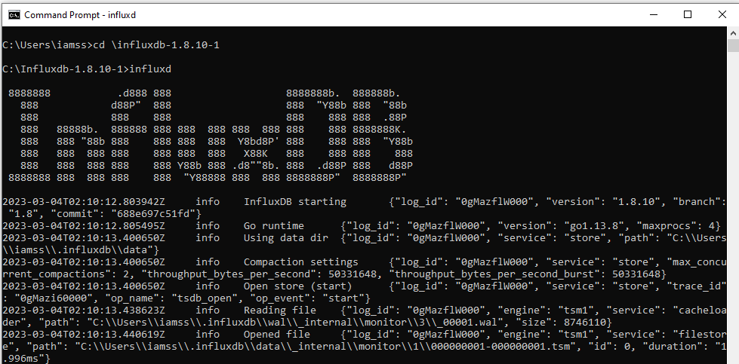
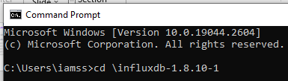
START INFLUXDB DAEMON/SERVICE
In folder in which I have installed my influxdb v1.8
Daemon is started
From here we start the influxdb daemon / service

Slide 10
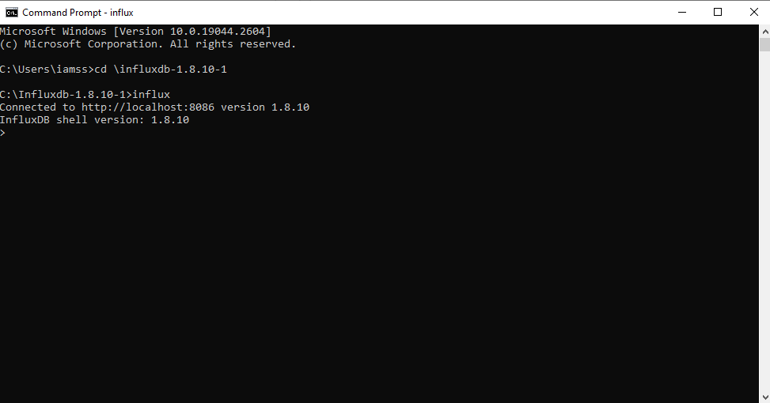
START INFLUXDB QUERY LANGUAGE
In folder in which I have installed my influxdb v1.8
Start another Window Terminal Session and cd to the folder
This is the Influx QL Interface

Slide 11
database
database
weather
measurements
Table: ChangiAirport
Influxdb Server
weatherdata
Table: Tampines
database
Table: Bedok
database
timestamp
locality
temp
humidity
pressure
database
values

Slide 12

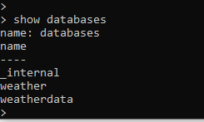
We create our databases to store our sensor data
> create database weatherdata
> To find out the databases in our influxdb server

Slide 13
To store data to the influxdb server
> create database weatherdata
> To find out the databases in our influxdb server

Slide 14
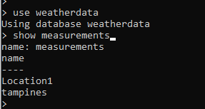
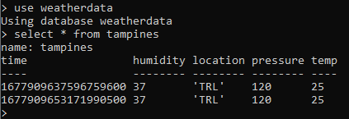
To insert data into the database e.g. weatherdata
> use weather
> insert tampines,location=‘TRL’ temp=25,humidity=37,pressure=120
To know what measurements [tables] there are in a given database
>show measurements
To know what values there are in a given measurement [table]
>select * from tampines

Slide 15

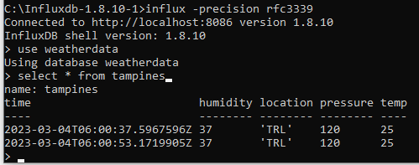
To exit from the Query Language interface
>exit
To show timestamp in human readable format
influx –precision rfc3339

Slide 16



HOW TO CREATE USERS AND GRANT PRIVILEGES
> Create USER Jamie with PASSWORD ‘ABCdef123’ WITH ALL PRIVILEGES
This user will have access to all the databases in the influxdb server
>create USER johnny with PASSWORD ‘XYX123’
This user will have limited access to databases in the influxdb server
>show users
>GRANT ALL ON weather to johnny
Johnny can access data in weather but not the other databases

Slide 17
For more QL commands, please refer to this link
https://songrgg.github.io/operation/influxdb-command-cheatsheet/

Slide 18
Pico as Data Logger
Connected to : ('192.168.1.95', '255.255.255.0', '192.168.1.1', '192.168.1.1')
Wifi
SSID=VirusGenerator
PWD=VGAquarius090317
upython Code
.py
192.168.1.100
Port: 8086
INFLUXDB
SERVER

Slide 19
Windows PC – Opening Port 8086
Control Panel
Security and Maintenance
Windows Defender | Firewall
Advanced settings
Inbound Rules
Actions
New Rule
Select Port
>>next
Select TCP
Specific local Port : 8086
Next
Allow the connection
Select all Domain Private Public
Next
Provide a name for this rule : InfluxDB8086
Give a Description is required
Finish
This rule will be added to your Inbound Rules which will allow traffic into Port 8086

